Slide 1
Predicting Possible Loan Default Using ML
Sharon Sam S

Slide 2
Loans, Banks, Customers
Loans are the core business of banks.
Main profit comes from loan’s interest.
A loan default occurs when a borrower takes money from a bank and does not repay the loan.
People often default on loans due to various reasons.
The loan companies grant a loan after an intensive process of verification and validation.
Not sure if the applicant is able to repay the loan.
So there is a need for a predicting loan default.

Slide 3
Loans, Banks, Customers
Solution
Build a classification model (Supervised Machine Learning) in which the target variable must need to be classified whether the loan will default or not (Yes | No).

Slide 4
Problem statement
Consider a business use case of a Bank which deals in all kinds of loans where the customer who borrows a loan will default or not.
The company validates the customer eligibility for the loan default.
The company seeks to automate the possibility of a loan will default or not based on customer detail provided while filling out online application forms.
To specifically target these customers by the usage of a product (flask web app) for best user interface experiences.

Slide 5
Data set description
ID: Id of the user(All Unique)
Income: Salary of the person
Age: Age of the person
Experience: Professional experience of the person in years
Profession: Profession of the person
Married/Single: Whether married or not
House_Ownership: Owned or rented or neither
Car_Ownership: Does the person own a car
STATE: State of residence
CITY: City of residence
CURRENT_JOB_YRS: Years of experience in the current job
CURRENT_HOUSE_YRS: Number of years in the current residence
Risk_Flag: Defaulted on a loan(Target variable)

Slide 6
Existing methodology:
Proposed methodology:
Data is imported
Pre-processing includes dropping of unwanted columns, converting categorical variables to numeric with binarise, OneHotEncoding and CountEncoding
Resampling the Data with Random Oversampler
Splitting the data into train and test splits with 30% as test set
Uses 3 different Classification Models and evaluate their metrics to find a best model for prediction
Metrics used are Recall, Precision, F1-Score, Accuracy score, AUC Score and roc curve
Creating a product (flask web app) for best user interface experiences
Data is imported
Preprocessing categorical variables with LabelEncoder, OneHotEncoder and CountEncoder
Splitting the data into train and test splits with 20% as test set
Uses a Random Forest Classifier
Metrics used are Recall, Precision, F1-Score, Accuracy score, AUC Score

Slide 7
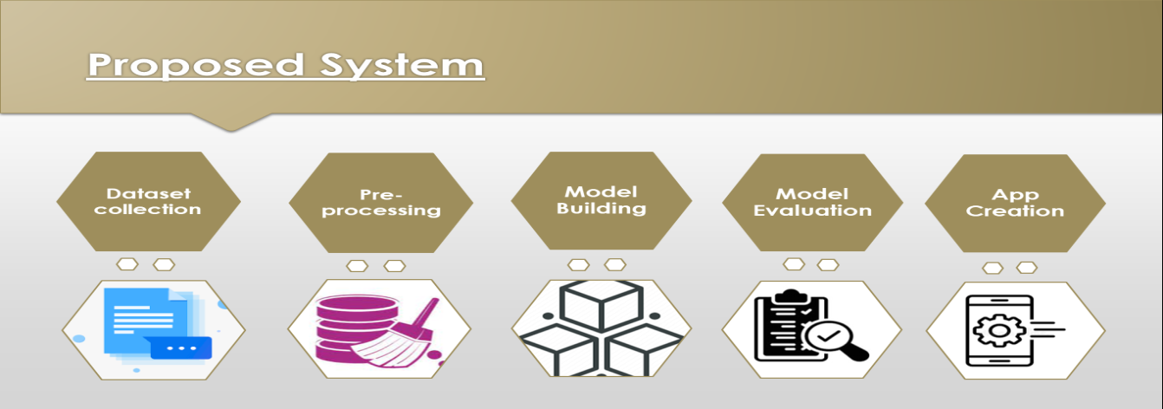
Implementation details: Flow Chart:

Slide 8
Implementation details:
Data collection and importing:
The dataset was imported in csv format using pandas dataframe and using the head function to take a glimpse at the data. The dataset had been explored using some methods like shape, size, info, describe, value_counts, etc.
EDA with visualizations:
Some analysis have been done using count plot, heatmap, box plot, histogram, and pie chart are used for study of distribution features and their relationship. Plotting relation between features and results to recognise patterns.

Slide 9
Implementation details:
Data Preprocessing:
Dropping the unwanted column - 'Id', 'CURRENT_JOB_YRS', 'CITY', 'STATE' had been dropped
Identify missing values - The dataset has no missing value found.
Converting categorical variables to numeric:
Marital_Status, Car_Ownership – binaries
Profession – count encoding
House_Ownership – one-hot
Resampling the data with Random Oversampler - Resampling because the data is highly imbalanced.

Slide 10
Split the dataset:
Implementation details:
Input Features – X
Output Feature - y
Test set is 30%

Slide 11
Model Building:
Implementation details:
1. Decision Tree Classifier
2. Random Forest Classifier
3. K Nearest Neighbors

Slide 12
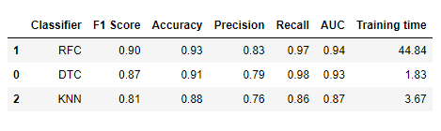
Building baseline models for the above 3 classifiers and evaluating their metrics to choose the best model.
The above image shows the evaluation metrics for the baseline models for the three classifiers. Of which Random Forest out performs other models with accuracy 90% and F1-score as 0.90. Thus we choose the Random Forest Classifier as the best model.

Slide 13
Experimental results and evaluation:
The metrics used for evaluating the models have been considered are Recall, Precision, F1-Score, Accuracy score, AUC Score and roc curve.
The baseline model for Random Forest Classifier is created and the accuracy is 93% with precision as 0.83 and recall as 0.97 which is comparatively good than other models.
Below given is the image about the different evaluation metrics, the classification report, the confusion matrix and ROC curve.

Slide 14
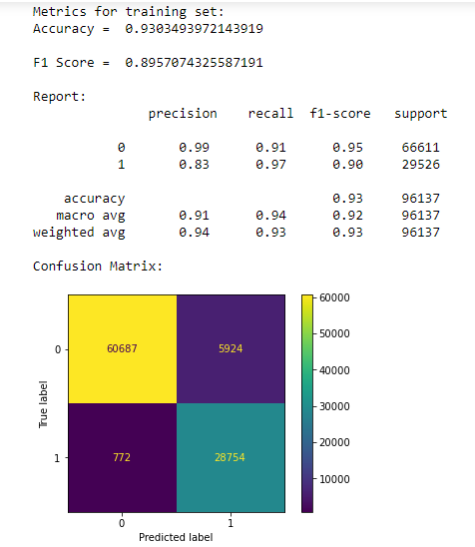
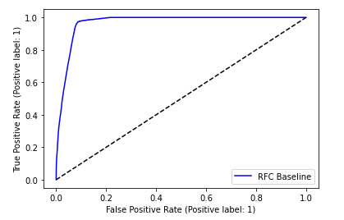
Results:

Slide 15
Real-time usage:
To meet the requirements of problem statement, we establish an application to assist the organization by creating an application using flask, a module in python to satisfy the needs.
The app creation is created with some folders :
1. Static which consists of css and image files.
2. Templates which has html files.
3. The python file app.py, which has the codes for running a flask app.
4. The pickle file model.pkl, which has the developed model in it.
5. Finally includes the preprocessed and sampled data.
To run the app locally, we code “python app.py” in the terminal prompt and the link generated is copied and pasted into the local browser to view and run the application. Thus aim of the project had been proposed and satisfied.

Slide 16
Conclusion:
The Random Forest approach is appropriate for classification tasks on datasets with many entries and features that are likely to have missing values when we need a highly accurate result while avoiding overfitting.
Predicting Loan Default is highly dependent on the demographics of the people, people with lower income are more likely to default on loans.
The scope of understanding the case study for Loan Default PREDICTION using ML have been grasped and developed by various steps such as data collection, data preprocessing, model building and evaluation and finally creating a real-time user application.
Successfully performed the classification task using Random Forest Classifier and also improved my accuracy comparing to the existing methodology. (The source accuracy was 88% while mine case study yields an accuracy of 93% which is an improvement).
Thus the problem statement is satisfied by predicting loan default and the flask app is created successfully for best user interface experiences.

Slide 17
Youtube link: https://www.youtube.com/watch?v=wYkw2P4ix_o
Reference URL:
https://www.analyticsvidhya.com/blog/2022/04/predicting-possible-loan-default-using-machine-learning/#h2_8
Code repository in GitHub: Github link: https://github.com/sharonsamsimpson/Loan_Default_Pred

